Slide 1
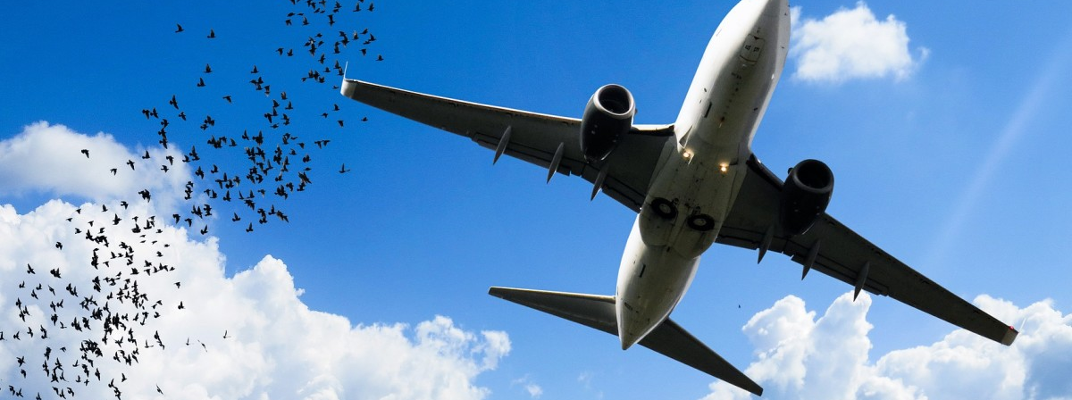
Wildlife Strikes

Slide 2

Here’s What’s Coming
Introduction
Datasets
Methods
Visualizations
Conclusions
Recommendations
Let’s go!

Slide 3
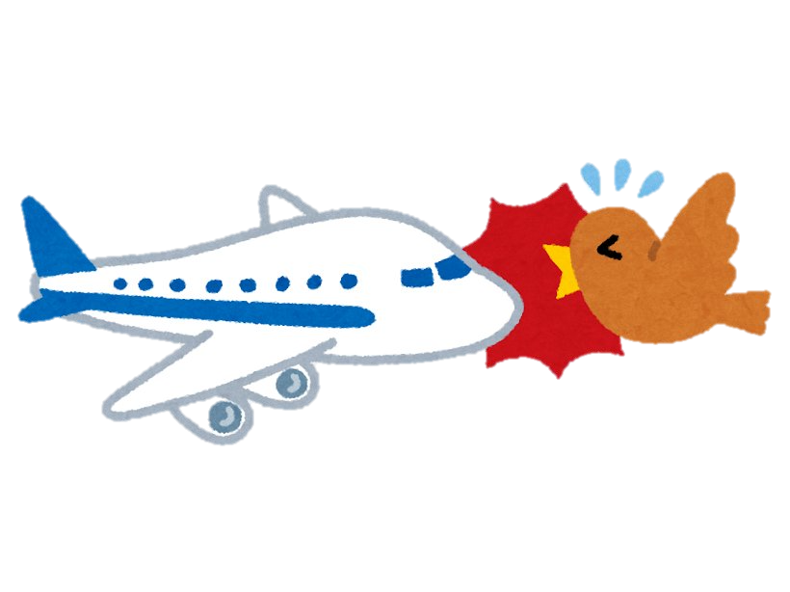
What is a bird strike?
A wildlife strike incident is defined as a collision between an aircraft and an animal during any / all phases of the flight, including those animals killed by the downwash of aircraft.
Wildlife strikes are serious hazards for both civil and military aircraft; military aircraft are under significantly increased risk due to their low flight paths, high velocities and single engines.

Slide 4

Datasets
Wildlife Strikes dataset
Contains data from 1990 to 2021
260,000 records, and 100 fields
Location: U.S covering all states
Aviation Dataset
Contains data from 1990 to 2021
88000 records, and 31 fields
Location: U.S covering all states
US State code mapping
Contains state abbreviations
Since the data contained is voluntarily reported, there is some noisy data is present in both datasets.

Slide 5

Methods
The large number of null and unknown values that skewed the query results. For example, we started cleaning the dataset by excluding null values and unknowns as necessary.
We joined the two datasets Aviation and Wildlife Strikes data using Outer join on column-registration number of the accident.
We also did some data transformations for the effective visualizations.

Slide 6
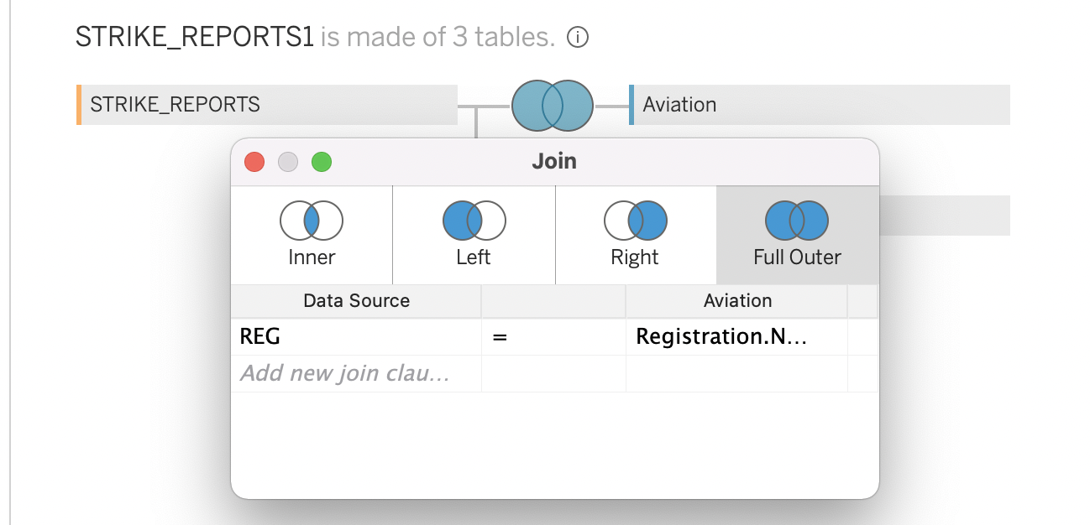
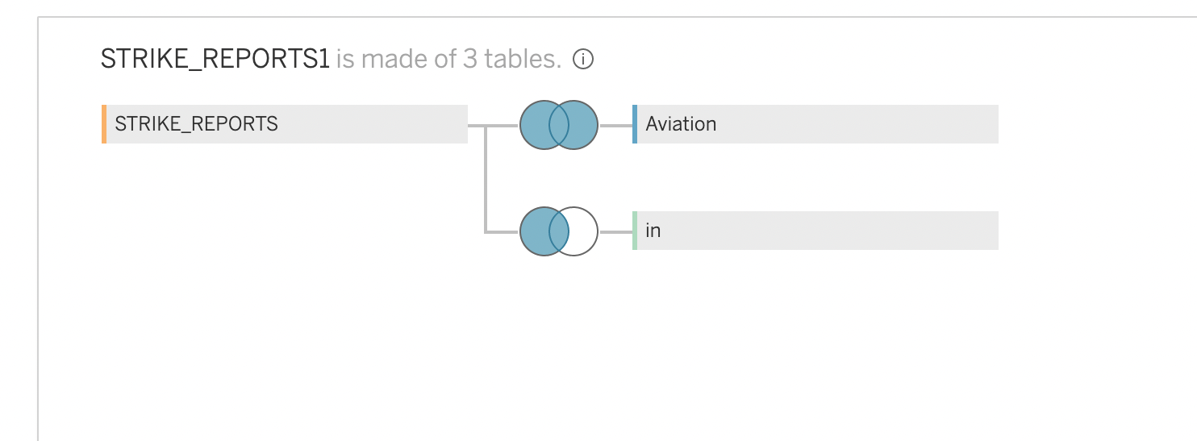
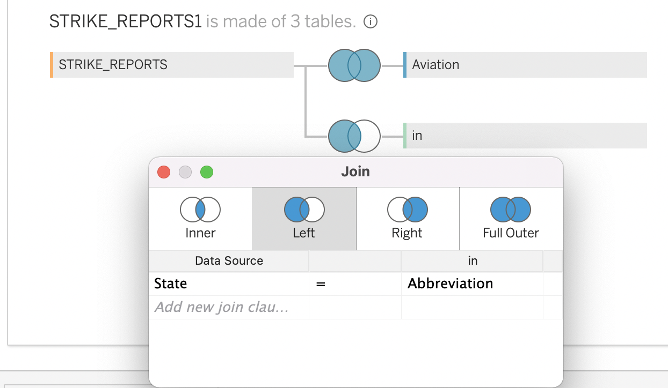
we joined the two datasets Aviation and Wildlife Strikes data using Outer join on column-registration number of the accident. Along with the two datasets, we also joined the US state code mapping table using the left join on state column which helps in mapping state codes with the state names.

Slide 7
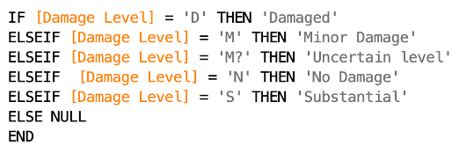

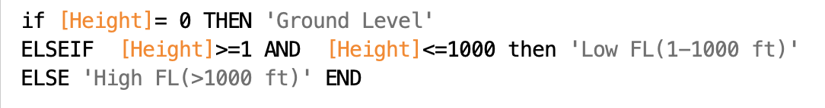


Some examples of Data transformations
‘Damage Level’
‘Total Cost’
‘Feet from Ground level’

Slide 8

Visualizations

Slide 9
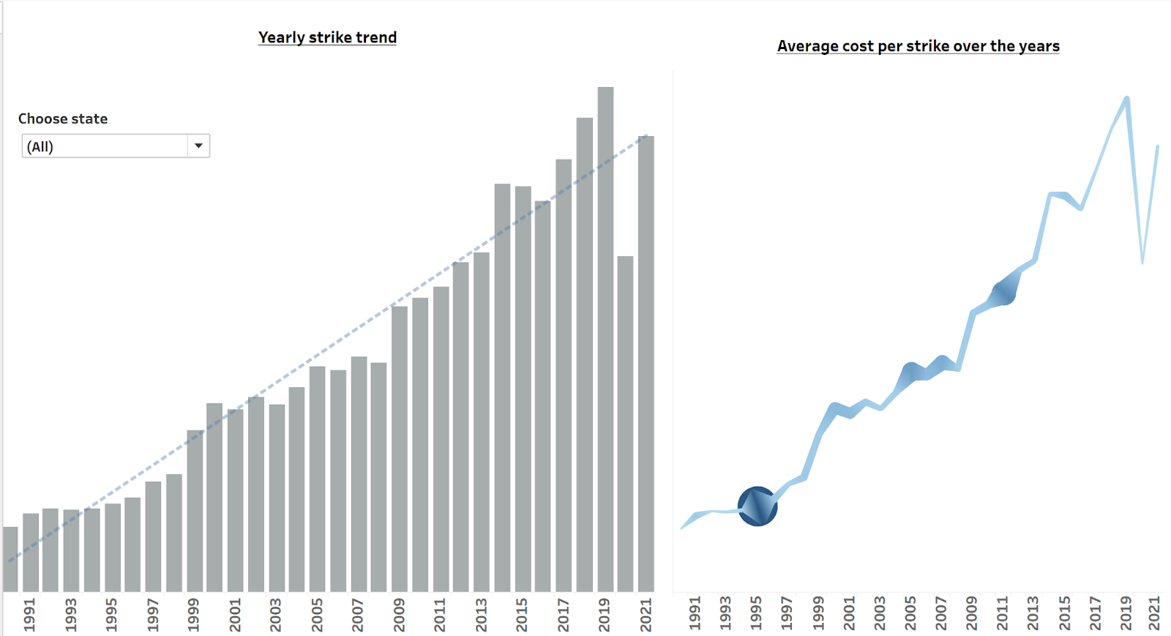
US Bird Strikes yearly trend

Slide 10
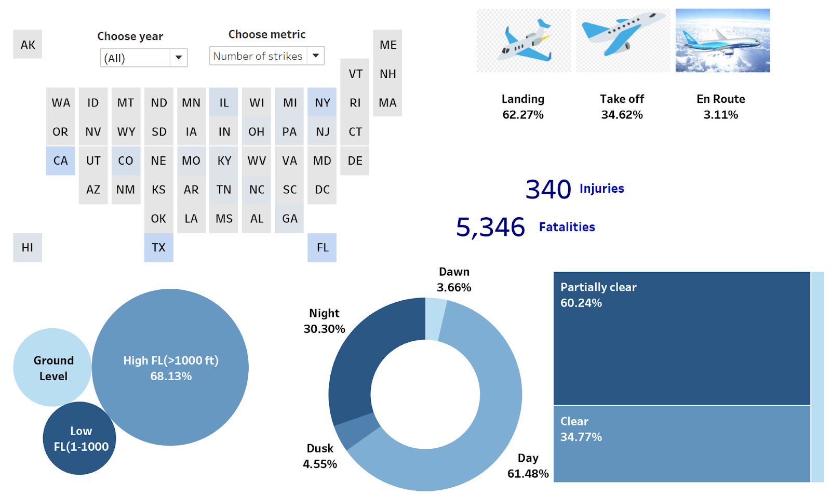
Overview of causes

Slide 11
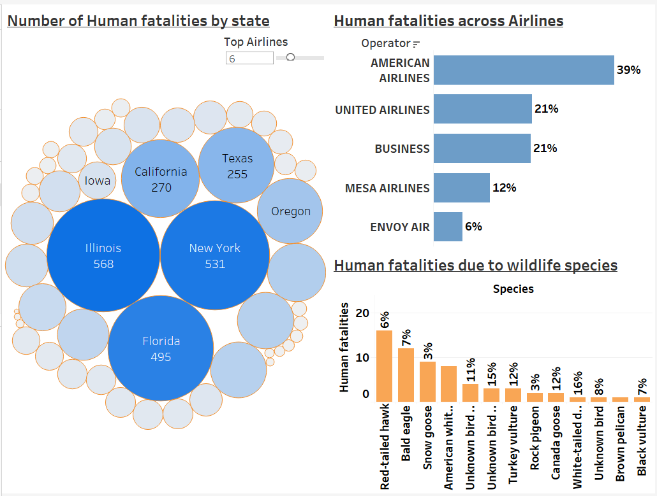
How worse are these strikes?

Slide 12
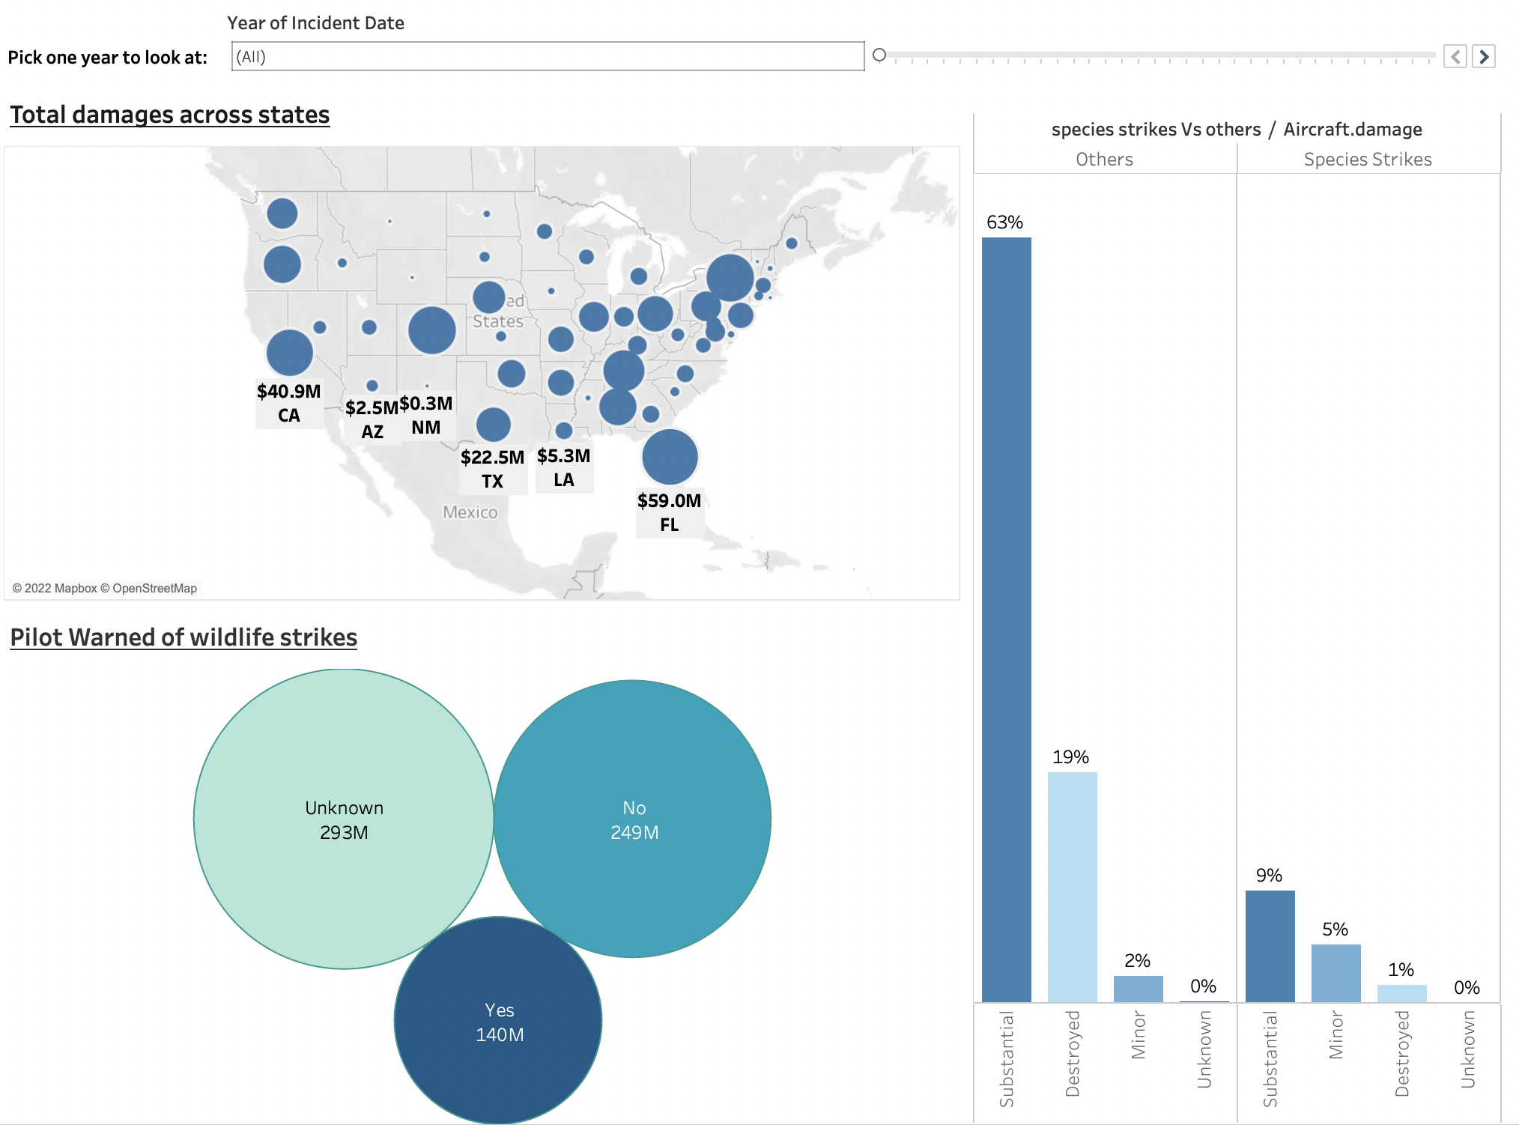
How much damage is caused by birds?

Slide 13
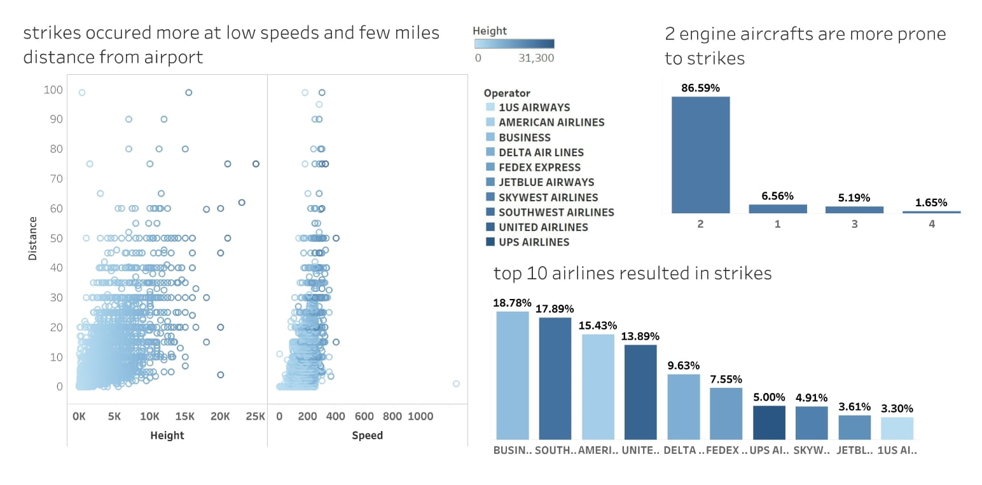
What are the trends in birds?

Slide 14
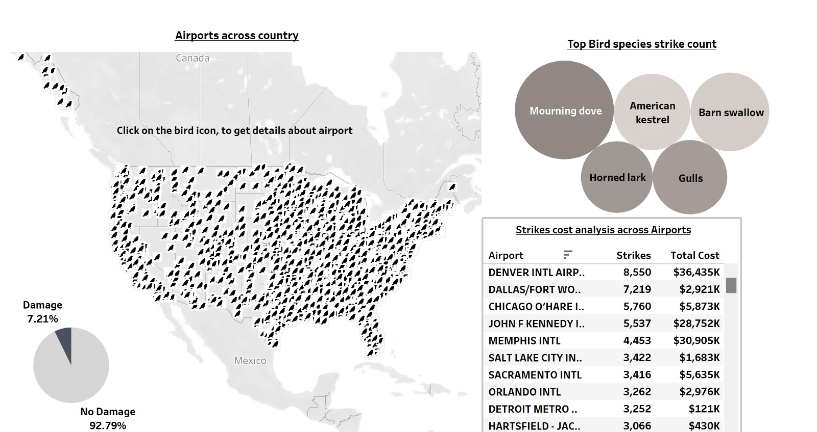
Where are the birds going?

Slide 15
Conclusions
Overall, 22.99% aviation accidents are occurred due to Species strikes.
In 2020 there is a 33% decrease from the record 17,359 strikes reported in 2019 to 11,705 strikes occurred in 2020.
Texas ,California ,Florida and New York have been the top states in terms of bird strikes during most of the time, which might be due to their coastal locations and size.
Higher number of strikes happened at Denver international airport, Colorado.
Summer being the most effected season with 91,724 strikes with 4.63% chance and flock of birds (more than 100) causes 35% of damage comparatively to a smaller number of birds.
Pilot warned of bird's causes $140M whereas Pilot doesn’t warn incurs more damages $249M.

Slide 16
Recommendations
Since most of the incidents occur at approach or departure when the airplanes are at low altitude and closer to the airport, we can minimize the attractiveness of the airport environment to birds by following
1) Modifying the habitat - Removing food sources, such as seed-bearing plants.
2) Controlling bird behavior - Flying trained falcons (or drones) over nesting sites to prevent birds from nesting.
3) Adapting flight times and paths - Adjusting flight times to avoid the busiest hours for bird activity, such as early morning and late evening, or to make alterations during seasonal migration periods.

Slide 17
Recommendations
Using trained birds to ward off the migratory birds from the airport locations can be a useful tool to reduce bird strikes.
Since the modern commercial jets are faster and less noisy, they often go undetected by the birds which results in bird strikes. The Aviation industry can add pulsating lights in the aircraft wings that have found to reduce the air strikes in other parts of the world.
The airlines industry can study the migratory bird's pattern and routes in the summer seasons. Avoiding such routes, if possible, could result in reduced bird strikes.
Training dogs to track through the airport and surrounding area as a visible threat
Closer monitoring, greater understanding and more targeted action is needed to counteract the fact that airports are getting busier, more flights are being scheduled and alternative habitats for birds are shrinking.

Slide 18
